Slide 1
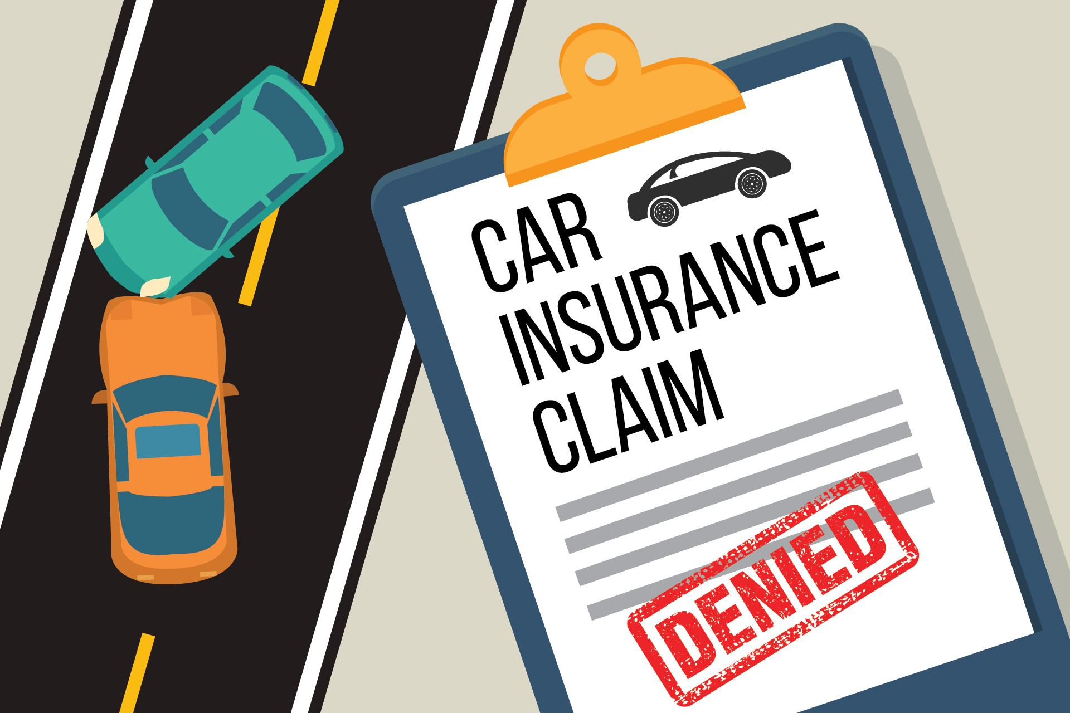
Did you know the average number of claims filed daily for auto insurance fraud and why?
This Photo by Unknown Author is licensed under CC BY-ND

Slide 2
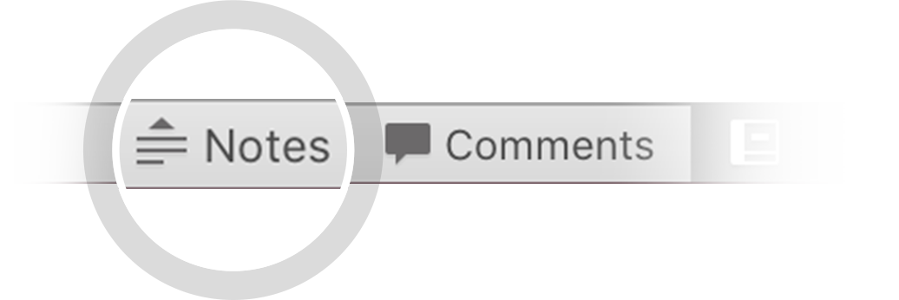
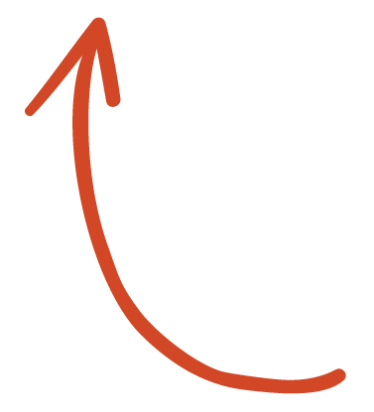
Key fact on insurance fraud:
Insurance fraud is any act committed to defraud an insurance process. This occurs when a claimant attempts to obtain some benefit or advantage they are not entitled to, or when an insurer knowingly denies some benefit that is due. According to the United States Federal Bureau of Investigation, the most common schemes include: premium diversion, fee churning, asset diversion, and workers compensation fraud. Perpetrators in these schemes can be insurance company employees or claimants. False insurance claims are insurance claims filed with the fraudulent intention towards an insurance provider.
See more: Open the Notes below for more information.
Notes:
QuickStarter has created an outline to help you get started on your presentation. Some slides include information here in the notes to provide additional topics for you to research.

Slide 3

INSURANCE FRAUD CLAIMS
:
The purpose of of this assignment was to determine property and casualty insurance fraud.
Let’s predict the riskiness of the loan.
The model is designed to predict the risk levels of an insurance policy holder that has filed a claim.
Reasons:
Fraud is an ongoing problem in the insurance industry which has an impact on premiums.
There is loss due to fraudulent data claims.
This Photo by Unknown Author is licensed under CC BY-SA

Slide 4
How we are going to address the project:
Flagging claims based on supervised learning model.
Description of the source of data: the data file was from kaggle.com
Exploration of the dataset was from https://www.kaggle.com/datasets/antopravinjohnbosco/auto-insurance-claims-fraud-detection
Description of the analysis phase of the project
Technologies, languages, tools, and algorithms used throughout the project
Result of analysis trajectory - possible larger data set
Recommendation for future analysis
h

Slide 5
Questions for the project:
Do claims have limitations and timeframes?
What determines an insurance claim to be detected or not detected as fraud?
Are police reports part of the justification of a non- fraudulent claim?
What are the max and min on fraudulent claims for property and casualty auto fraud cases?
Will you be denied insurance due to a fraudulent claim with your insurance?

Slide 6
Insurance Fraud: can result from many claims that were not exactly proven.

Slide 7
Suggestions for assess fraud process to develop data to analyze:
Scrub the data and streamline data > for example drop the names.
Supervised Machine learning.
Logic regression model.
Determine a threshold for fraud validation to claims.
The data set will be described how it will be split into training and testing.
Explain the model’s confusion matrix to fraud claims.
Final accuracy score and how it is measured in the world of insurance claim fraud.
SQL will be utilized to create new datasets to be merged and extract transform the datasets for various comparisons and analysis fraudulent or not fraudulent claims.
visualization with Tableau will be presented to show fraud variation

Slide 8
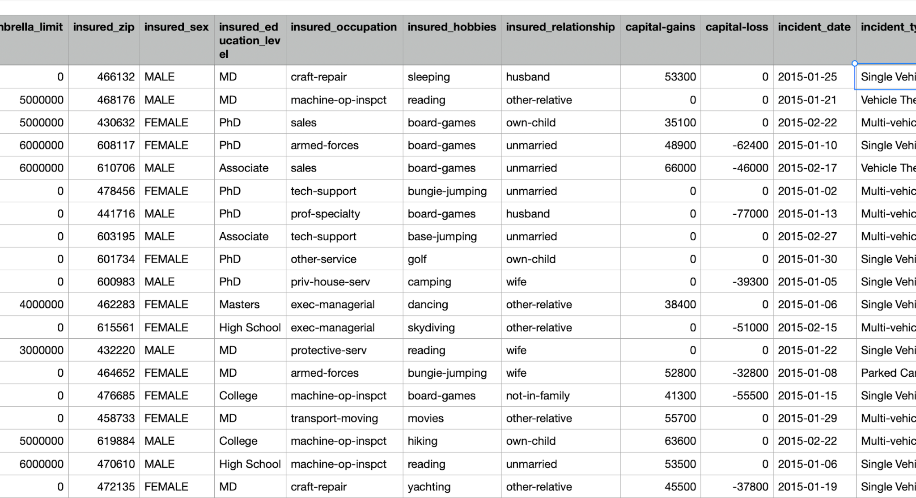
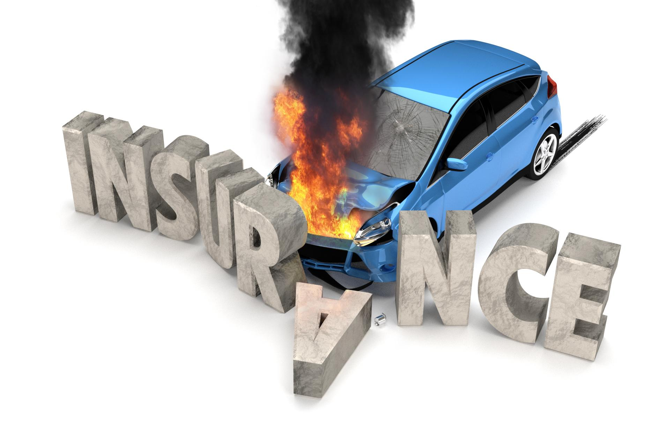
DATA FILES
Raw data from kaggle.com

Slide 9
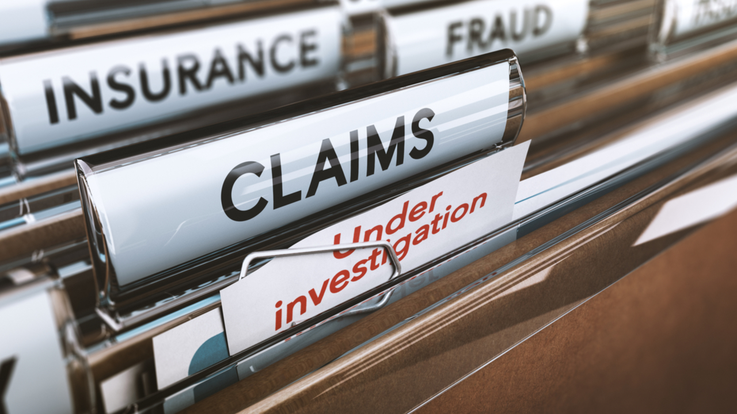
CREDIT RISK ~ DEFAULT
Good standing as a policyholder vs bad standings
based on default. credit and driver level of risk.
A driver fakes and accident and unscrupulous people support the mishandling of P & C claims.
A driver and body shop worker agrees to inflate the auto damage claim and share the ”PROCEEDS”.
A driver and body shop worker agrees to inflate the auto damage claim and share the ”PROCEEDS”.
A driver and body shop worker agrees to inflate the auto damage claim and share the ”PROCEEDS”.
This Photo by Unknown Author is licensed under CC BY-NC-ND

Slide 10
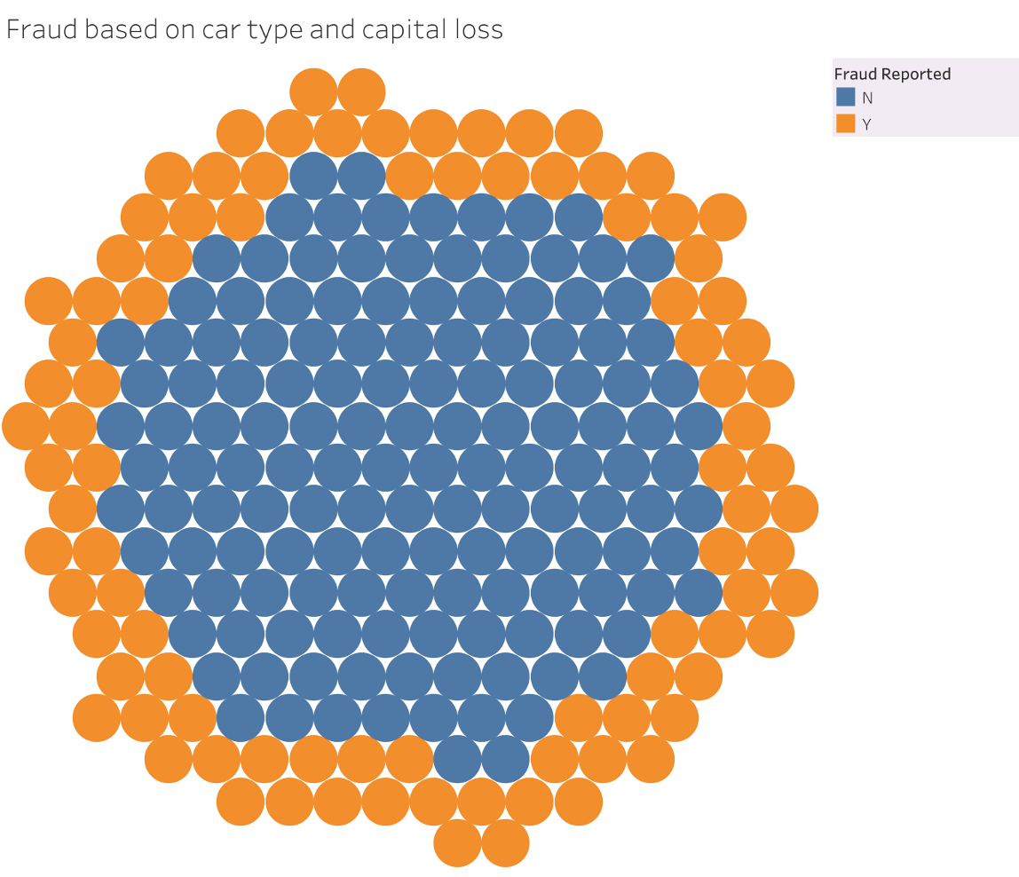
WE CLASSIFY ~ fraud proceeds.

Slide 11
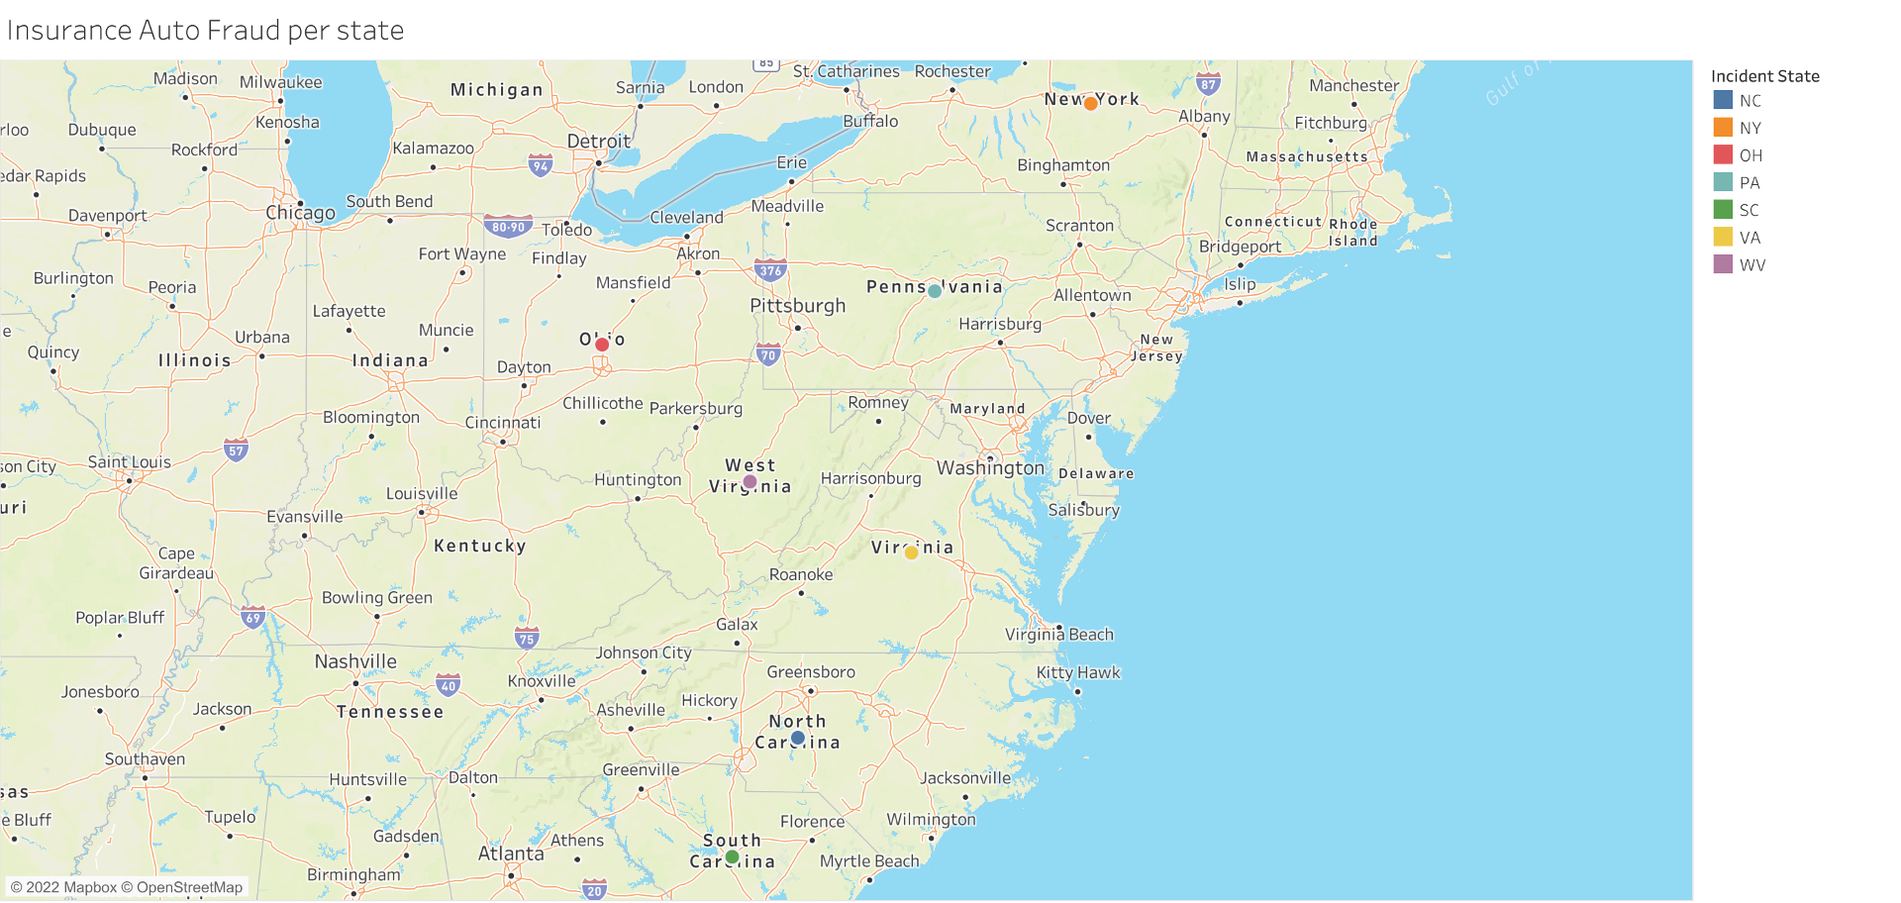

Slide 12
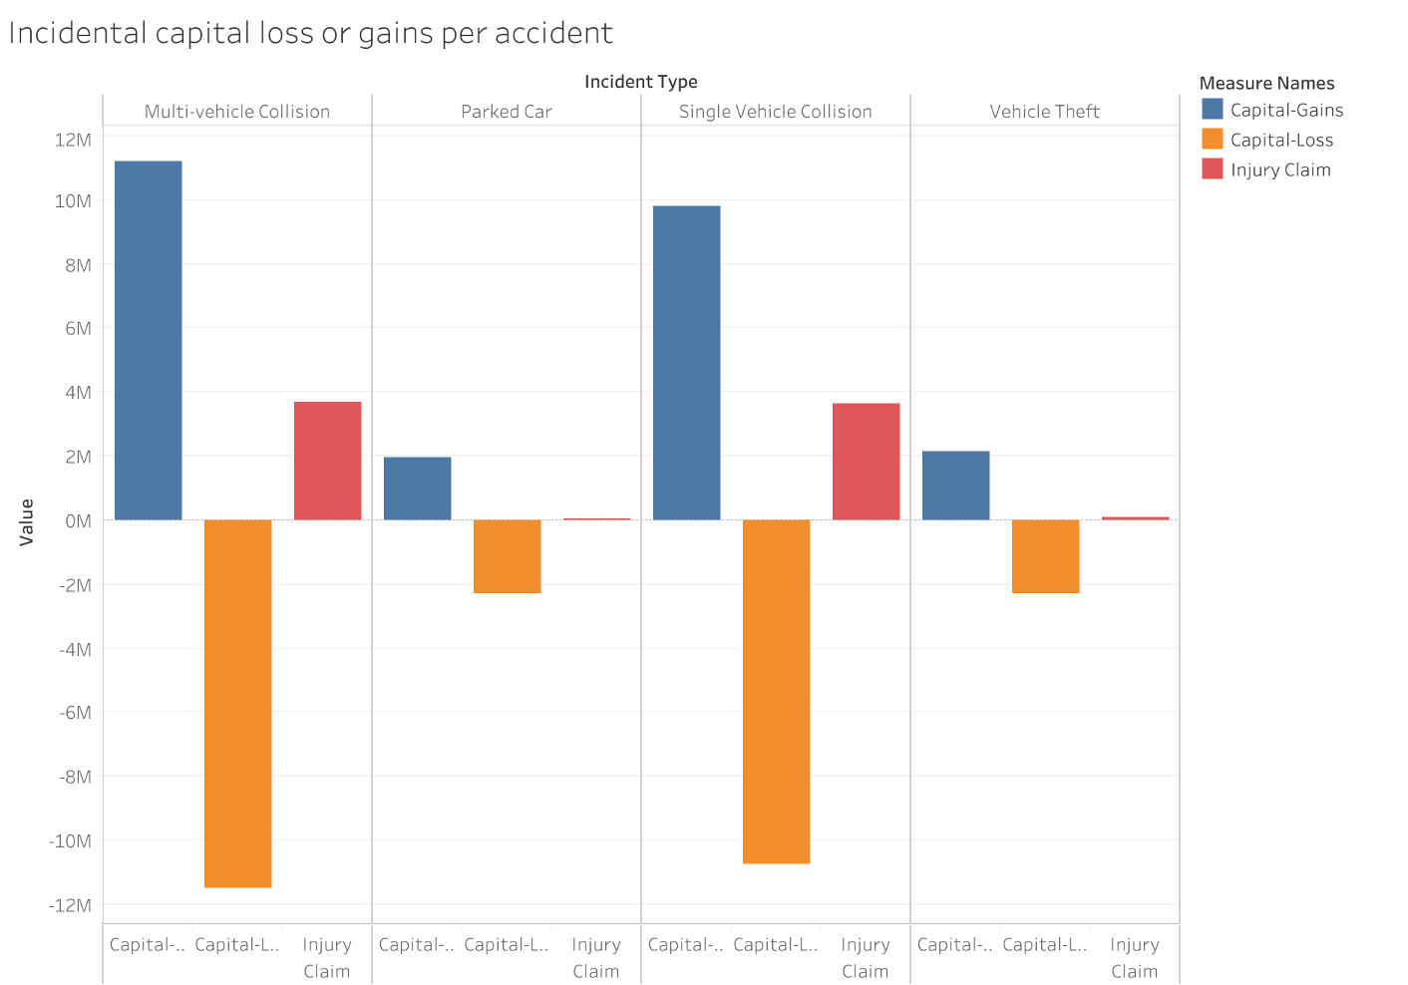

Slide 13
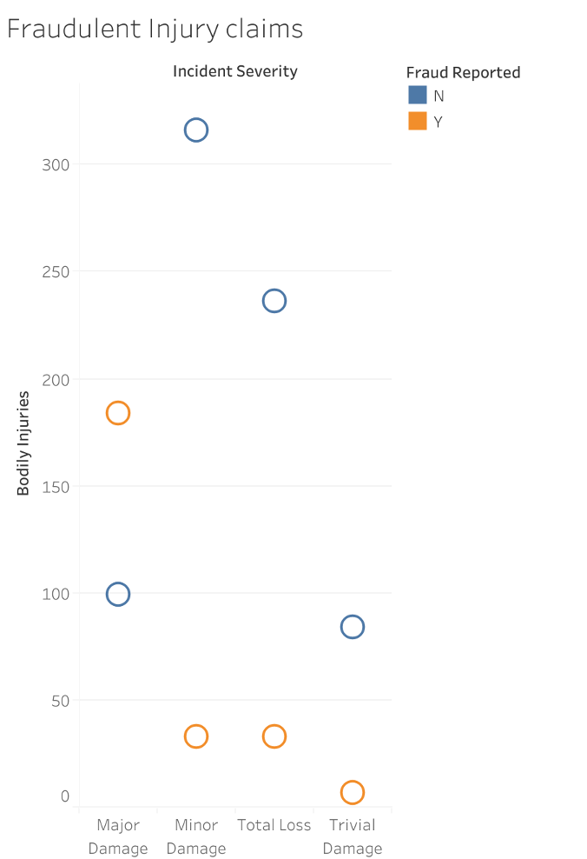

Slide 14
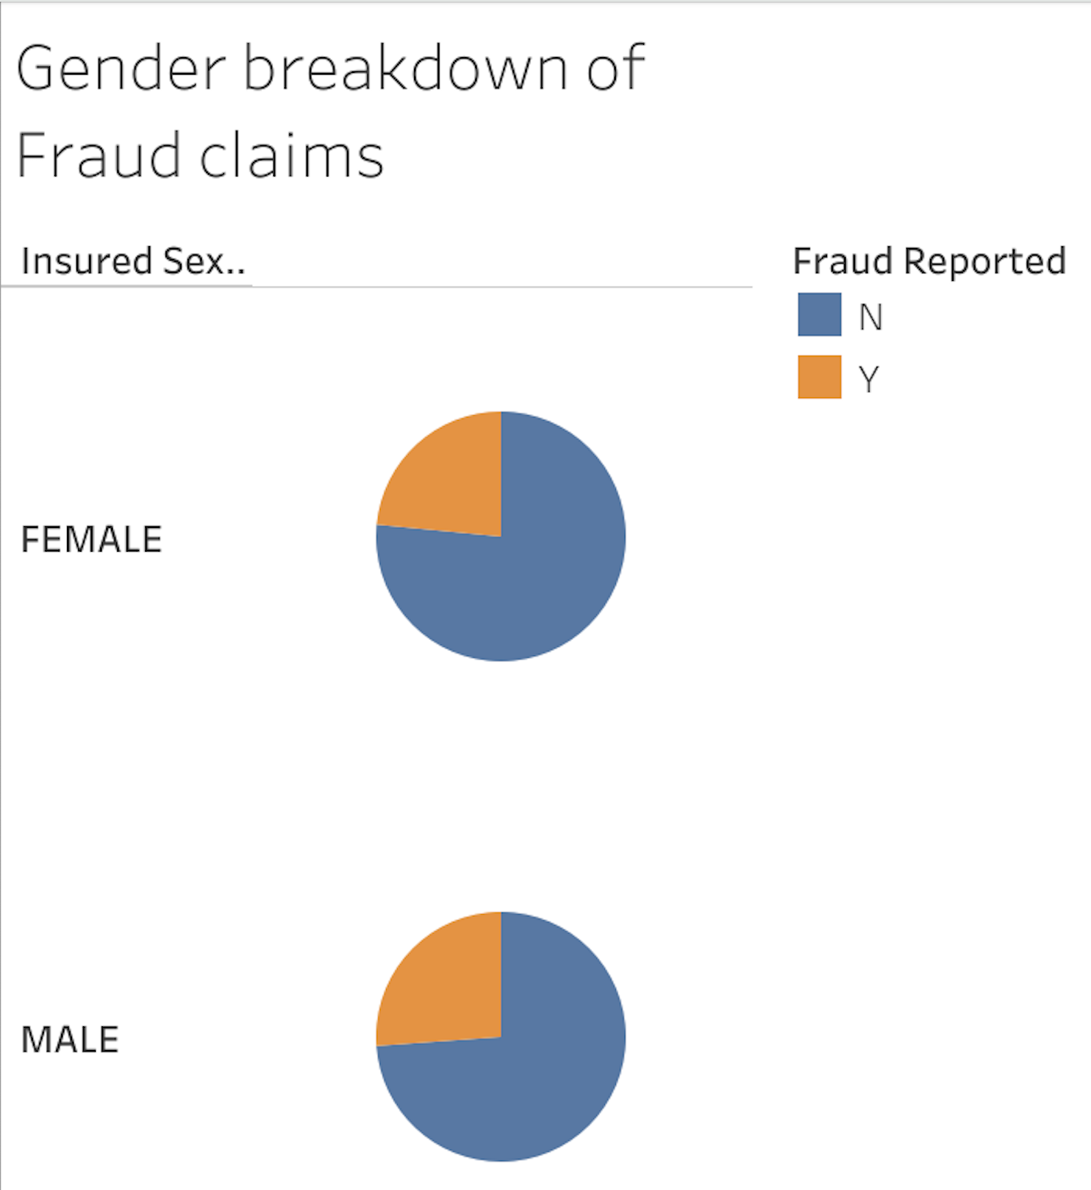
Who committed auto insurance fraud?

Slide 15
Did you know the average number of claims filed daily for auto insurance fraud and why?
This Photo by Unknown Author is licensed under CC BY-ND

Slide 16
Key fact on insurance fraud:
Insurance fraud is any act committed to defraud an insurance process. This occurs when a claimant attempts to obtain some benefit or advantage they are not entitled to, or when an insurer knowingly denies some benefit that is due. According to the United States Federal Bureau of Investigation, the most common schemes include: premium diversion, fee churning, asset diversion, and workers compensation fraud. Perpetrators in these schemes can be insurance company employees or claimants. False insurance claims are insurance claims filed with the fraudulent intention towards an insurance provider.
See more: Open the Notes below for more information.
Notes:
QuickStarter has created an outline to help you get started on your presentation. Some slides include information here in the notes to provide additional topics for you to research.

Slide 17
INSURANCE FRAUD CLAIMS
:
The purpose of of this assignment was to determine property and casualty insurance fraud.
Let’s predict the riskiness of the loan.
The model is designed to predict the risk levels of an insurance policy holder that has filed a claim.
Reasons:
Fraud is an ongoing problem in the insurance industry which has an impact on premiums.
There is loss due to fraudulent data claims.
This Photo by Unknown Author is licensed under CC BY-SA

Slide 18
How we are going to address the project:
Flagging claims based on supervised learning model.
Description of the source of data: the data file was from kaggle.com
Exploration of the dataset was from https://www.kaggle.com/datasets/antopravinjohnbosco/auto-insurance-claims-fraud-detection
Description of the analysis phase of the project
Technologies, languages, tools, and algorithms used throughout the project
Result of analysis trajectory - possible larger data set
Recommendation for future analysis
h

Slide 19
Questions for the project:
Do claims have limitations and timeframes?
What determines an insurance claim to be detected or not detected as fraud?
Are police reports part of the justification of a non- fraudulent claim?
What are the max and min on fraudulent claims for property and casualty auto fraud cases?
Will you be denied insurance due to a fraudulent claim with your insurance?

Slide 20
Insurance Fraud: can result from many claims that were not exactly proven.

Slide 21
Suggestions for assess fraud process to develop data to analyze:
Scrub the data and streamline data > for example drop the names.
Supervised Machine learning.
Logic regression model.
Determine a threshold for fraud validation to claims.
The data set will be described how it will be split into training and testing.
Explain the model’s confusion matrix to fraud claims.
Final accuracy score and how it is measured in the world of insurance claim fraud.
SQL will be utilized to create new datasets to be merged and extract transform the datasets for various comparisons and analysis fraudulent or not fraudulent claims.
visualization with Tableau will be presented to show fraud variation

Slide 22
DATA FILES
Raw data from kaggle.com

Slide 23
CREDIT RISK ~ DEFAULT
Good standing as a policyholder vs bad standings
based on default. credit and driver level of risk.
A driver fakes and accident and unscrupulous people support the mishandling of P & C claims.
A driver and body shop worker agrees to inflate the auto damage claim and share the ”PROCEEDS”.
A driver and body shop worker agrees to inflate the auto damage claim and share the ”PROCEEDS”.
A driver and body shop worker agrees to inflate the auto damage claim and share the ”PROCEEDS”.
This Photo by Unknown Author is licensed under CC BY-NC-ND

Slide 24
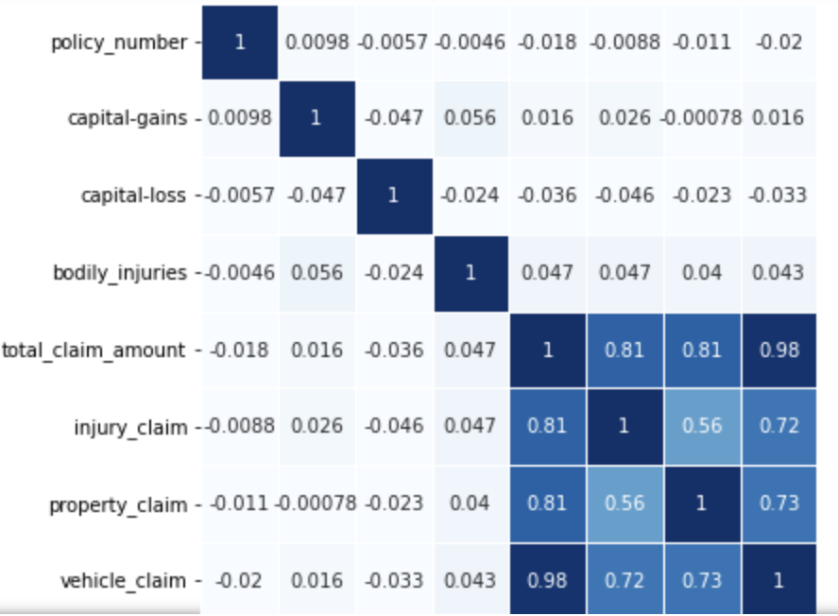
WE CLASSIFY ~ fraud proceeds.

